Slide 1
PSYC 740 Theory Building and Model Testing
Session 12 – Common Method Variance, Power, and Other issues in SEM

Slide 2
Overview of Slides
AIC and BIC
Comparing non-nested models
Common method variance (CMV)
CFA/SEM solutions to CMV
Power and SEM

Slide 3
AIC and BIC

Slide 4
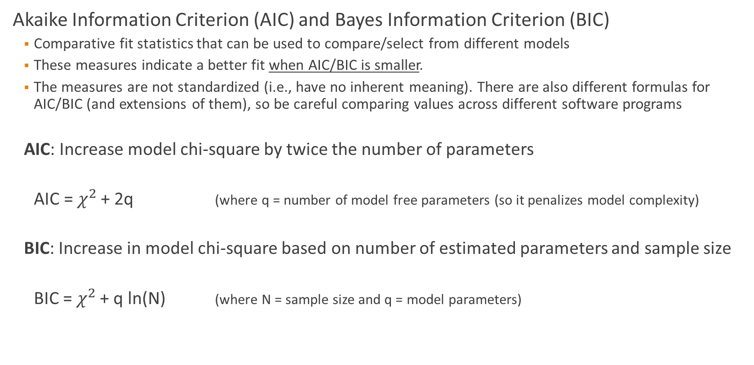
Additional Goodness of Fit Statistics
Akaike Information Criterion (AIC) and Bayes Information Criterion (BIC)
Comparative fit statistics that can be used to compare/select from different models
These measures indicate a better fit when AIC/BIC is smaller.
The measures are not standardized (i.e., have no inherent meaning). There are also different formulas for AIC/BIC (and extensions of them), so be careful comparing values across different software programs
AIC: Increase model chi-square by twice the number of parameters
AIC = $χ^{2 }$+ 2q (where q = number of model free parameters (so it penalizes model complexity)
BIC: Increase in model chi-square based on number of estimated parameters and sample size
BIC = $χ^{2 }$+ q ln(N) (where N = sample size and q = model parameters)

Slide 5
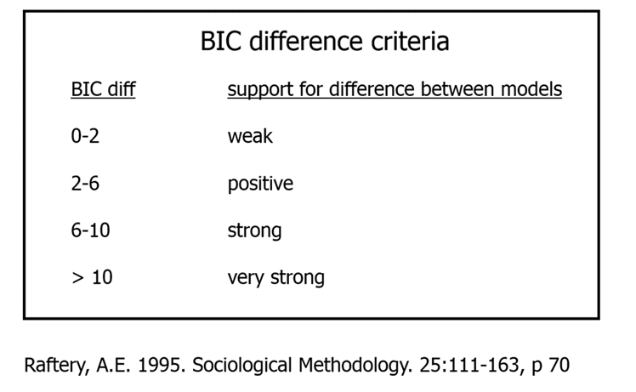
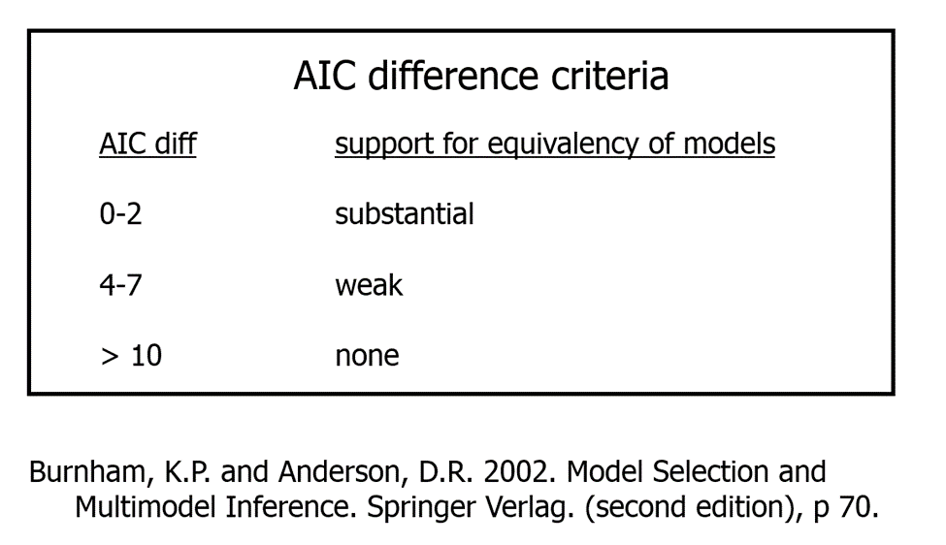
Model Comparisons
The absolute value of AIC or BIC have relatively little meaning; rather the focus is on the relative size between models, the model with the smaller AIC/BIC being preferred.

Slide 6
Comparing Non-Nested Models
Measures of AIC and BIC can be used to compare nested models. Though debated, AIC and BIC have often been said to be able to compare non-nested models.
However, this would only be the case for non-nested models that still use the exact same measured/observed variables.
If the non-nested models contain any different measured/observed variables, comparing AIC and BIC values would not be appropriate.
Vuong’s (1989) nonnested likelihood ratio test (LRT) can also be used. The nonnest2 package in R can be used to compare models (including lavaan models) using this method as well as to contrast AIC/BIC values across models

Slide 7
Comparing Non-Nested Models (continued)
If the non-nested models contain different measured/observed variables, difficult to know how to directly compare them.
Some recommendations:
Compare which models align with theory the most
Assess the model fits (both global and local fit) of the various models separately
Assess the predictive fit of the various models (e.g., R-squared of some outcome construct/variable)
Assess the cross-validation of the various models

Slide 8
Common Method Variance/Bias

Slide 9
Common Method Variance (CMV)
Definition:
Systematic error variance shared among variables measured with and introduced as a function of a shared method and/or source.
Can either inflate or attenuate relationships, but is most commonly expected to cause inflation when ‘‘the method variance components of the individual measures are more positively related than an underlying true relationship’’

Slide 10
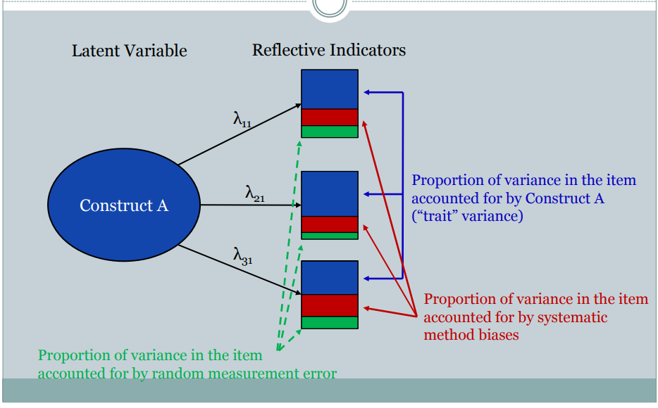
Illustration at the indicator level

Slide 11
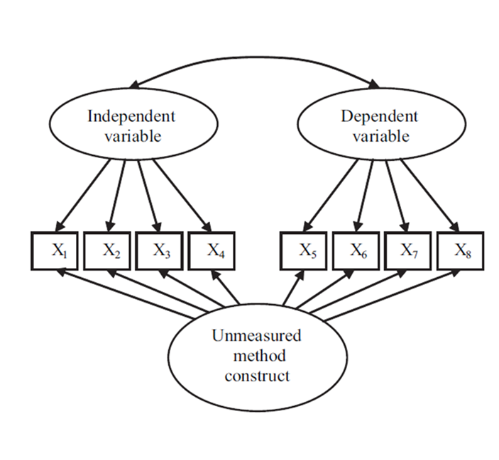
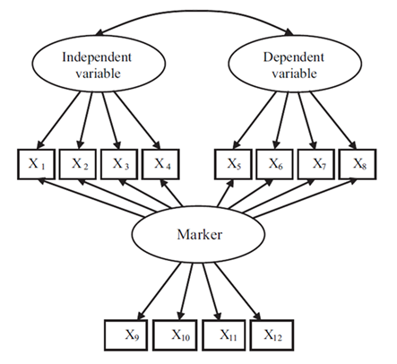
Basic Approaches to Assessing CMV
Use of marker variables
Correlational marker (Lindell & Whitney,2001)
Identify single marker variable and then adjust/partial other correlations
Confirmatory factor analysis (CFA) marker
Explicitly model latent construct of marker variable(s)
Unmeasured latent method construct (ULMC)
Unmeasured latent construct with direct predictions of all of the relevant indicators

Slide 12
Marker Variable Characteristics
Definition: a variable that is not expected to be theoretically related to substantive variables in the model, but that captures or taps into one or more sources of bias that can occur in the measurement context for given substantive variables, given a model of survey response bias
Quality of a marker variable is the degree to which it
is influenced by the same causes of CMV (e.g., social desirability, acquiescence) as a set of substantive variables,
but is not theoretically related to those substantive variables.
Rationale -- if there is no theoretical reason for expecting a marker to be related to at least one other study variable, the amount of CMV present in data is the extent to which the absolute observed correlation between the marker and the theoretically unrelated variable departs from 0.00.
Critical assumption -- responding to the marker elicits similar cognitive processes or response tendencies as those prompted by substantive items, thereby making it prone to the same CMV causes.
Note -- markers do not directly measure CMV, but rather are proxies for it. CMV measurement requires a defensible, a priori assumption of no substantive relationship between a marker and other variables or there is no conceptual basis for concluding that observed marker relationships are a function of CMV instead of “true” relationships.

Slide 13
Potential Sources of Method Bias/Error
From a respondent’s perspective, method bias is generally associated with “satisficing” behavior when responding, such that an overall effect becomes embedded in their responses.
Three general sources:
Undermining the capabilities of the respondent
Examples: lack of ability or experience, complicated or abstract items, “double-barreled” items or ambiguity, retrospective recall
Decreasing the barriers to satisficing
Examples: common scale attributes, grouping related items, availability of prior answers
Decreasing the motivation to respond accurately
Examples: low personal relevance or self-efficacy in responding, low need for cognition or self-expression, forced participation, interviewer presence, suspicious context
Source: MacKenzie and Podsakoff (2012) “Common Method Bias in Marketing: Causes, Mechanisms, and Procedural Remedies”

Slide 14
“Best Practices” For Marker Variables
Explicitly name and describe the markers, including response scale format or other measurement properties that make it similar to substantive study variables
Report the marker variable in the study correlation matrix so that the magnitude of its relations with other variables can be assessed.
Identify the marker technique (correlational or CFA) implemented
Describe why no theoretical relationship between the marker and other study variables is expected—preferably with theoretically based arguments or, at a minimum, with citations from prior research.
Discuss the marker’s theoretical content and susceptibility to CMV relative to other study variables (i.e., detail why the marker was chosen and indicate which types of bias they believe it captures)
Report whether the marker was chosen a priori to assess substantive unrelatedness and the types of CMV it may represent.
Source: Simmering, et al (2015),”Marker Variable Choice, Reporting, and Interpretation in the Detection of Common Method Variance: A Review and Demonstration”

Slide 15
Method 1: Correlational Marker Technique (CMT)
Assumes single unmeasured factor with equal effect on all variables
5 recommended steps:
Choose smallest correlation among marker and substantive variables
Use partial correlation: subtract correlation above from zero order correlation between substantive variables (numerator), subtract above from value of 1.0 (denominator)
Is original correlation reduced to non-significance?
Address measurement error: correct correlations for attenuation using reliabilities of variables
Sensitivity analysis: compute additional partial correlations using lower and higher amounts of method variance (using confidence interval of marker correlation)

Slide 16
Methods 2 and 3: Latent variable approaches
Unmeasured latent method construct (ULMC)
Unmeasured latent construct, essentially a bi-factor model similar to MTMM (Multi-Trait Multi-Method)
See if the correlation between the designated factors remain after adjusting for the unmeasured latent construct
CFA Marker Technique
Can address all steps of CMT approach, as well as test assumption of equal method effects and directly address measurement error

Slide 17
Power and SEM

Slide 18
SEM Requires Large Samples
SEM is considered a large-sample technique. But “what is large enough”?
More complex models, or those with more parameters, require bigger sample sizes.
Analyses in which all outcome variables are continuous and normally distributed, all effects are linear, and there are no interactions require smaller samples sizes
Larger sample sizes are needed if score reliability is low.
The amount of missing data affects sample size requirements
Special sample size considerations for particular kinds of SEM
Larger sample sizes needed in factor analyses when there are relatively few indicators per factor
Some indicators covary noticeably with multiple factors
The number of factors increase
Covariance between factors are relatively low

Slide 19
Rules of Thumb
There is no simple rule of thumb about sample size that works across all studies and models
Plus, sample size requirements in SEM can be considered from at least two different perspectives:
The number of cases required in order for the results to have adequate statistical precision
Minimum sample sizes needed in order for significance tests in SEM to have reasonable power
Kline (textbook) rough guidelines for latent variable models where all outcomes are continuous and normally distributed and ML estimation is used:
A N:q rule where researchers think about minimum sample sizes in terms of the ratio of the number of cases (N) to the number of model parameters that require statistical estimates (q)
Recommended sample-size-to-parameters ratio is 20:1
Some people have said 10:1 is a satisfactory ratio (but not ideal)

Slide 20
Power Analysis
Direct power analysis for SEM models can be done at both the model level and the individual parameter level
These power analyses are often carried out through Monte Carlo simulation techniques
See the online links on Canvas for some helpful resources on performing SEM power analyses (Session 12 module)

